Slide 1
RAJALAKSHMI ENGINEERING COLLEGE
Department of Information Technology
FIRST REVIEW
STRESS DETECTION AND REDUCTION IN
IT PROFESSTIONALS
SUPERVISOR
DR S KAYALVIZHI ,B.Tech , M.E, Ph.D.
Assistant Professor(SG),
Department of IT,REC
TEAM MEMBERS
SREEKRISHNA P A(181001093)
SRIMANJEY R (181001095)
SUGUMARAN B(181001102)

Slide 2
OUTLINE
Objective
Abstract
Introduction to Problem Domain
Existing system
Limitation of the Existing System
Proposed system
Architectural design for Proposed system
ER ,Use case Diagram
Algorithm/Technique Used
Expected Outcomes
References

Slide 3
OBJECTIVE
The main objective of the Stress Detection In IT Professional by Image Processing and Machine Learning is to detect the stress level of the IT professionals and providing them remedies to reduce stress and become more efficient.
The system helps in reducing stress and creating an healthy environment for the IT professionals to become more efficient and focused.

Slide 4
ABSTRACT
There is an unavoidable need to make sure the wellbeing of employee who contribute to the success of the company.
Nowadays, IT industries are developing at a rapid pace in the market by introducing new technologies and deadlines and it requires its employee’s to cope up with its pace which leads to stress.
Therefore, there is a need to develop a system that tracks the health of the employee so that they work efficiently and suggest remedies to reduce stress in case of stress.

Slide 5
INTRODUCTION TO PROBLEM DOMAIN
A professional can work efficiently as long as they stay physically fit and mentally healthy.
An employee become stressed when they are allotted unachievable targets and are unable to manage a given situation. This leads to increased stress and reduced efficiency.
With the advent of COVID-19 pandemic, employee’s were highly stressed due to long hours of work and limited option to reduce stress due to lockdown and curfew.

Slide 6
EXISTING SYSTEM
In the existing system, to recognize depression level, Brindahini Vimaleswaran [1] proposed a solution for detecting the depression level in youth and providing them therapy.
They used feed-forward Neural Network (FFNN) for image processing and detecting depression level.
In the driver stress monitoring system [2],the system is used to detect the driver stress dynamically and which may alert the driver and analyse the data by using the Xgboost algorithm.

Slide 7
LIMITATIONS OF EXISTING SYSTEM
The depression level approach by Vimaleshwaran[1] focuses only on youth facing depression.
It notes only limited emotions such as disgust , happy and contempt.
The classification of the images to predict depression resulted in only 62% accuracy.
The system does not have a standard scoring pattern, formula or algorithm to identify the depression severe state.
Limitations of driver stress monitoring system is that using Xgboost algorithm only recognition has been done so the Xgboost algorithm is dependent.

Slide 8
PROPOSED SYSTEM
Stress Detection system is existing in various sectors, but we mainly focus to enhance the IT sector to help both the organization and its employees.
Concepts like implementing the stress detection have been developed before however this project focuses on to promote an healthy work environment and an efficient work culture.
In addition we also provide suggestions to employees based on their stress level helping them to stay relaxed and at the same time being efficient.
Herewith we are using the algorithm of mini-Xception zwhich is efficient to recognize the facial emotion of an individual.

Slide 9
PROPOSED SYSTEM
The system identifies stress level of each employee by the facial emotion and eyebrow displacement.
Based on the level of stress it provides remedies to reduce stress such as suggesting rest, playing stress reduction game, meditation for a few minutes, playing classic sounds, and providing food coupons to the employees, participation in sports activities and gym.
This helps the employees to relax, stay motivated and become more focused and efficient.

Slide 10
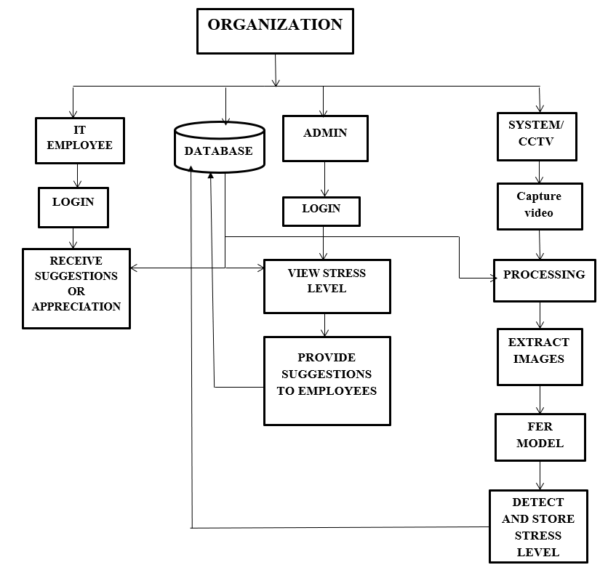
ARCHITECTURAL DESIGN FOR PROPOSED SYSTEM
FER MODEL – FACIAL EMOTION RECOGNITION MODEL

Slide 11
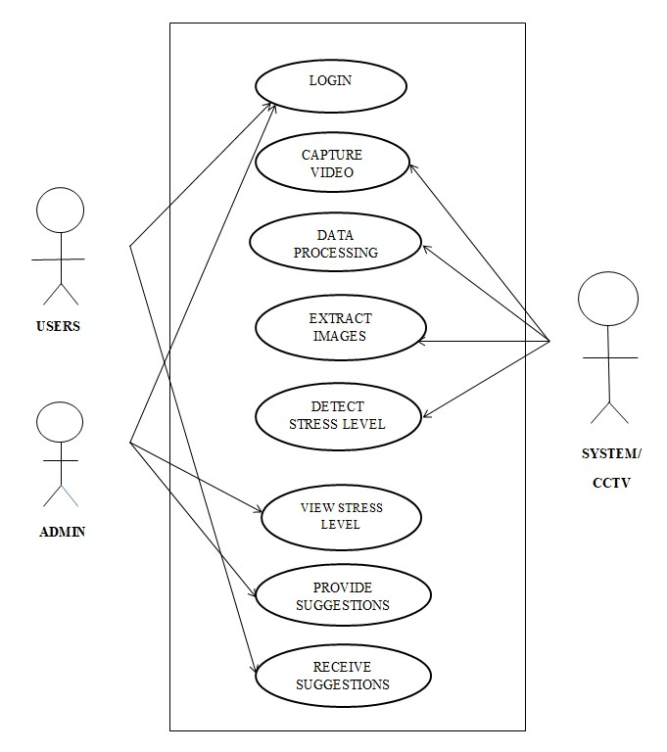
ER/ USE CASE DIAGRAM

Slide 12
ALGORITHM/ TECHNIQUE USED
The system uses mini-Xception model to extract emotions from images processed from real-time video .
Mini-Xception, is a pre-trained convolution model, which is used for image classification, object detection , etc.
The mini-Xception model is used to extract features from images, which is used for emotion detection and stress level calculation.

Slide 13
EXPECTED
OUTCOMES
A system based on image processing technique which analyses the stress experienced by an employee at real time and calculates the stress level.
Based on the stress level, it provides the employees with remedies and suggestions to reduce stress.
An healthy work environment is necessary for efficient work by employees and profit for the organization.

Slide 14
ADVANTAGES OF
PROPOSED SYSTEM
The proposed architectures have been systematically built in order to reduce the amount of parameters.
By using CNN with mini-Xception, it helps in eliminating completely the fully connected layers and reducing the amount of parameters in the remaining convolutional layers making the system fast.
Also the system provides real-time remedies to its employees promoting an healthy work culture.
The CNN-TL model is more feasible than the CNN prototypes and the models that can adopt different TL methods which have advantages in either working accuracy or speed for different tasks.

Slide 15
REFERENCES
References in IEEE Format
1.Brindahini Vimaleswaran Andreoli, Gayashini Shyanka Ratnayake “E - Therapy Improvement Monitoring Platform for Depression using Facial Emotion Detection of Youth” 2021 Third International Conference on Intelligent Communication Technologies and Virtual Mobile Networks (ICICV) March 2021.
2. Yue Lu, Xinsha Fu, Enqiang Guo, Feng Tang "XGBoost Algorithm- Based Monitoring Model for Urban Driving Stress: Combining Driving Behaviour, Driving Environment, and Route Familiarity" 2021 January 2021.
3. S. Kumar D, Varshney G. Dhawan and H. Jalutharia "Analysing the Effective Psychological State of Students using Facial Features" 2020 4th International Conference on Intelligent Computing and Control Systems (ICICCS) May 2020.
4. Gen-Min Lin, Masanori Nagamine , Szu-Nian YangYueh-Ming Tai , Chin Lin , SHiroshi Sato "Machine Learning Based Suicide Ideation Prediction for Military Personnel" 2021 IEEE Journal of Biomedical and Health Informatics April 2020.

Slide 16
THANK YOU

